Slide 1

Automata Theory Lecture: 17 Derivation and Derivation Trees
Farhad Muhammad Riaz

Slide 2
Derivation
S → aB | bA
S → a | aS | bAA
S → b | aS | aBB
Suppose we have a string
aabbabba

Slide 3
Derivation
S aB S → aB aaBB B → aBB aabB B → b aabbS B → bS aabbaB S → aB aabbabS B → bS aabbabbA S → bA aabbabba A → a
S aB S → aB aaBB B → aBB aaBbS B → bS aaBbbA S → bA aaBbba A → a aabSbba B → bS aabbAbba S → bA aabbabba A → a

Slide 4
Derivation
S → A1B
A → 0A | ε
B → 0B | 1B | ε
00101

Slide 5
Derivation
S
A1B
0A1B
00A1B
001B
0010B
00101B
00101

Slide 6
Derivation Tree
S → aB | bA
A → a | aS | bAA
B → b | bS | aBB

Slide 7
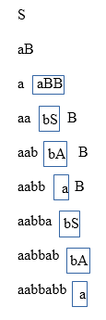
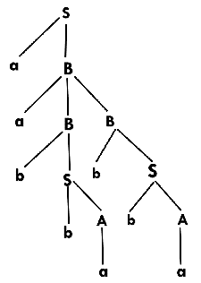

Slide 8
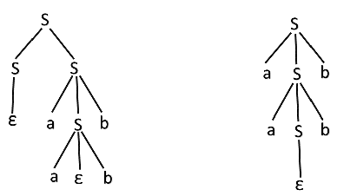
S → aSb | SS
S → ε
String = aabb

